Slide 1
Develop a PUF-based mutual authentication framework for FPGA targeting secure data exchange in an AMI-like smart metering infrastructure and integration of DLMS/COSEM communication principles
R Harshavardhan
IMT2022515

Slide 2
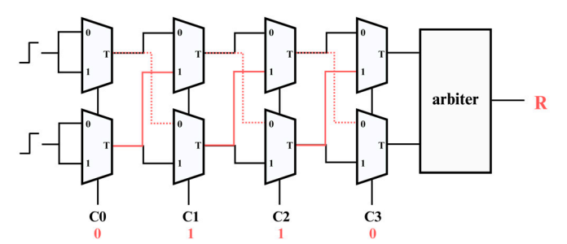
PUF Survey
SRAM based PUF
  Exploits the power-on initialization state of SRAM cells.
  Initialization of each SRAM cell to 0 or 1 depends on minor manufacturing differences, resulting in a unique bit pattern.
Arbiter based PUF
  Generates a unique response by transmitting two
  signals along separate paths within the circuit and
  determining which signal arrives first at the destination
Ring Oscillator PUF
  Uses multiple ring oscillators and compares the frequency of each
  oscillator to produce a unique response.

Slide 3
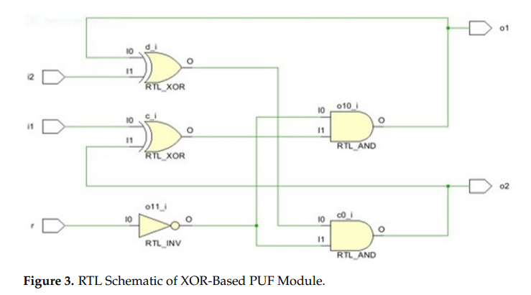
PUF Survey
Cross-Coupled XOR gate race condition
  Forming a race condition that is resolved in
  hardware to generate a response bit.
IO pin based PUF in microcontrollers
  Exploits parasitic capacitances of I/O pins
  Exploits pull-up/down resistors on the IO pins of the ICs
LED based PUF
  LEDs exhibit unique light patterns at low brightness levels.
  Derives signatures from the light patterns emitted by LEDs

Slide 4
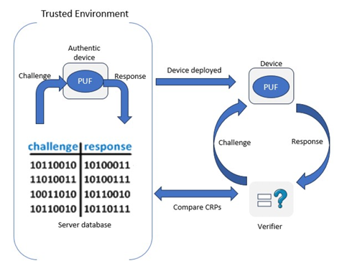
How PUF output is used in IDoT?
A Server cannot determine if the edge node is a genuine meter or a cloned device.
Each node contains a unique PUF that generates a hardware-rooted identity that cannot be easily cloned.
Server stores CRPs of node before
operation.
Server sends challenge → PUF ↓
Auth (R, Challenge) ← Response R
Meter sends relevant data through LoRa.
Notes:
Mention hashing

Slide 5
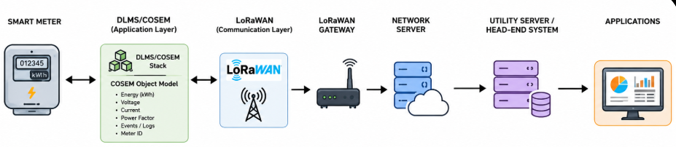
COSEM/DLMS
DLMS/COSEM is the globally accepted smart metering standard that defines a common communication protocol and data model for secure meter info exchange in AMI systems.
DLMS -Device Language Message Specification
Communication protocol for smart meters.
COSEM - Companion Specification for Energy Metering
Data model that defines how meter data is organized and accessed.
Provides a common format for exchanging meter readings and control commands, even across different meter manufacturers.

Slide 6
Module-Lattice-based Key Encapsulation Mechanism
What it is?
How it works?
ML-KEM is a NIST-standardized PQC algorithm, designed to remain secure against both classical and quantum computer attacks.
IoT infrastructures in the future must be resistant quantum computer based attacks
Enables two nodes to share a secret cryptographic keys over insecure communication channels.
Key Generation
  Server generates a public key (PK) and private key (SK).
Encapsulation
  Smart meter uses the server's public key to generate a shared secret (K), a ciphertext (C) which is sent to the server.
Decapsulation
  Server uses its private key and the received ciphertext to recover the same shared secret K.
Session Key Derivation
  Both parties derive an AES session key from the shared secret.
Notes:
shor's algo, used to break traditional encryption algorithm like RSA

Slide 7
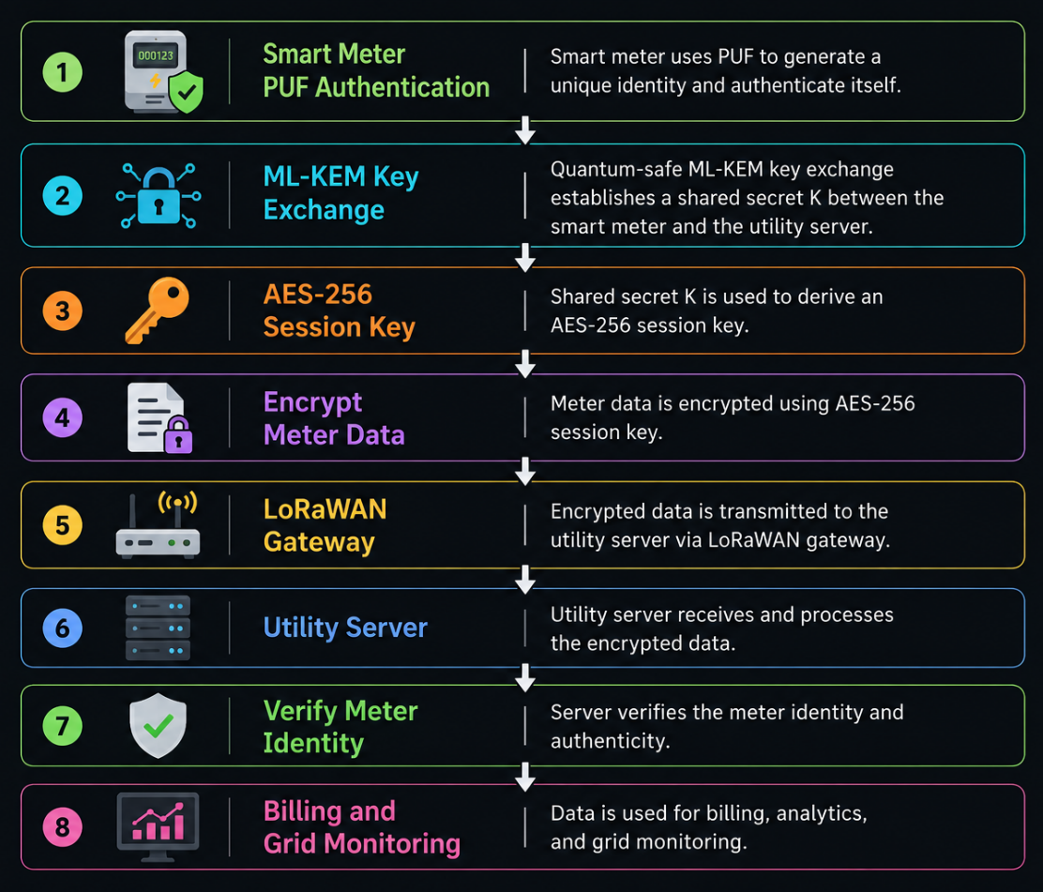
PQC - PUF - IoT : Relevance
Smart meters communicate sensitive data
which is vulnerable to future quantum
computer attacks.
PUFs can create a unique identity
but IDs stored in memory can be
extracted through physical attacks.
ML-KEM : Quantum-safe key exchange.
  Resistant to known quantum attacks.
The key is used in AES encryption
to send encrypted data over channels.
Notes:
Where does hashing come into the picture in PQC?

Slide 8
How is puf resposne related to meter id?

Slide 9
Pqc-hash-puf

Slide 10
Resources
Research chat
ML-KEM github
The Implementation of the Physical Unclonable Function in a Field-Programmable Gate Array for Enhancing Hardware Security
A Secure FPGA-Based IoT Gateway for Smart Home Automation Using PUF-Based Authentication

